Slide 1
Angular 4 Session

Slide 2
AngularJS
JavaScript-based open-source front-end web application framework.
To develop single-page applications.
A framework for client-side model–view–controller (MVC) architecture.
AngularJS is the frontend part of the MEAN stack.
Unit testing ready.
Expressive, readable, and quick to develop.
<script src="https://ajax.googleapis.com/ajax/libs/angularjs/1.6.4/angular.min.js"></script>

Slide 3
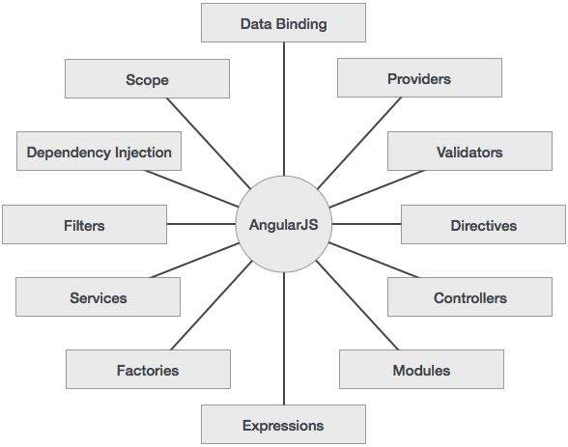
Concepts

Slide 4
Controller
var app = angular.module(‘customerApp', []);
app.controller('realCustomer', function($scope) {
$scope.customer = {
'Name' : 'John',
'Address' : '12-13-283/A1',
'Email' : ‘John.J@cognizant.com'
}
});

Slide 5
HTML
<html ng-app=“customerApp">
<div ng-controller="realCustomer">
<h3>{{ customer.Name }} </h3>
<h3>{{ customer.Address }} </h3>
<h3>{{ customer.Email }} </h3>
</div>
</html>

Slide 6
Angular 1 vs 2
Angular 2 is written entirely in Typescript and meets the ECMAScript 6 specification.
Component-based development and object oriented.
A component is a controller class with a template and styles that belong to it.
Scopes and controllers are canceled completely.
Improved Dependency Injection model.

Slide 7
TypeScript
TypeScript is a typed superset of JavaScript that compiles to plain JavaScript.
Open source and Supported by all the browsers and OS.
TypeScript is an extension of ECMAScript, in fact:
TypeScript = ES6 + Types + Annotations
Supports object-oriented programming.
Transpilation - TypeScript code has to be translated(compiled) into JavaScript.

Slide 8
TypeScript – Example 1
greeter.ts (Pure Javascript) :
function greeter(person) {
return "Hello, " + person;
}
var user = "Jane User";
document.body.innerHTML = greeter(user);

Slide 9
TypeScript – Example 2
greeter.ts (with type annotation)
function greeter(person: string) {
return "Hello, " + person;
}
var user = "Jane User";
document.body.innerHTML = greeter(user);

Slide 10
TypeScript – Example 3
greeter.ts
class Student {
fullName: string;
constructor(public firstName, public middleInitial, public lastName) {
this.fullName = firstName + " " + middleInitial + " " + lastName;
}
}
interface Person {
firstName: string;
lastName: string;
}
function greeter(person : Person) {
return "Hello, " + person.firstName + " " + person.lastName;
}
var user = new Student("Jane", "M.", "User");
document.body.innerHTML = greeter(user);

Slide 11
Angular 4 - Recent release
Angular 4 is not a complete rewrite of Angular 2.
Animations being pulled out of @angular/core.
Improved Performance and Modularity.
Faster compilation
Support for native mobile - iOS and Android.
Improved testability.

Slide 12
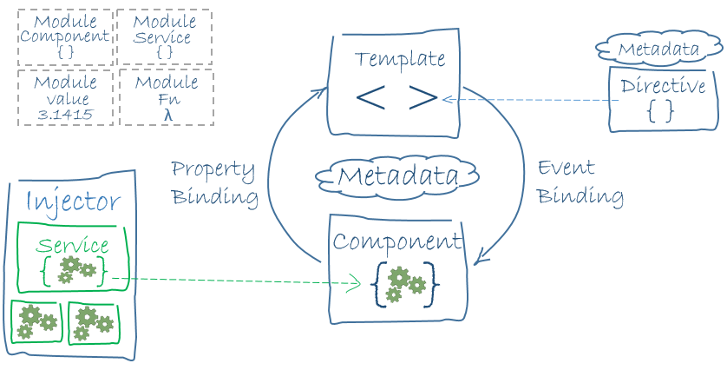
Angular 4 - Architecture

Slide 13
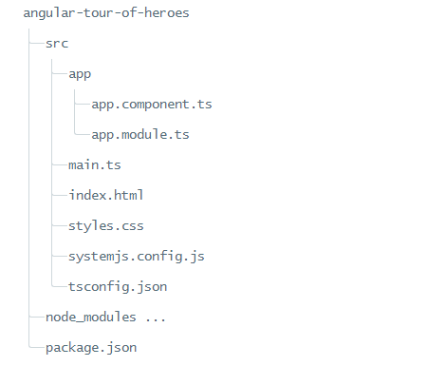
Project structure

Slide 14
Node.js and npm package
Node.js and npm are essential to modern web development with Angular and other platforms.
Node.js, an execution environment for event-driven server-side and networking applications.
The npm package manager, itself a node application, installs JavaScript libraries.

Slide 15
Project setup
git clone https://github.com/angular/quickstart.git quickstart or Download the sample project from Angular.io site
cd quickstart
npm install
npm start
Delete non-essential files (optional)
for /f %i in (non-essential-files.txt) do del %i /F /S /Q
rd .git /s /q
rd e2e /s /q

Slide 16
Package.json
{
"name": "angular-helloworld",
"version": "1.0.0",
"description": "Helloworld package.json from the documentation with testing support",
"scripts": {
"build": "tsc -p src/",
"build:watch": "tsc -p src/ -w",
},
"keywords": [],
"author": "",
"license": "MIT",
"dependencies": {
"@angular/core": "~4.0.0",
"@angular/forms": "~4.0.0",
},
"devDependencies": {
"concurrently": "^3.2.0",
"lite-server": "^2.2.2"
},
"repository": {}
}

Slide 17
HelloWorld Example
src/main.ts:
import { platformBrowserDynamic } from '@angular/platform-browser-dynamic';
import { AppModule } from './app/app.module';
platformBrowserDynamic().bootstrapModule(AppModule);
src/app/app.module.ts:
import { NgModule } from '@angular/core';
import { BrowserModule } from '@angular/platform-browser';
import { AppComponent } from './app.component';
@NgModule({
imports: [ BrowserModule ],
declarations: [ AppComponent ],
bootstrap: [ AppComponent ]
})
export class AppModule { }

Slide 18
HelloWorld Example
src/app/app.component.ts:
import { Component } from '@angular/core';
@Component({
selector: 'my-app',
template: `<h1>Hello {{name}}</h1>`
})
export class AppComponent {
name = 'Angular';
}
index.html:
<my-app>Loading AppComponent content here ...</my-app>

Slide 19
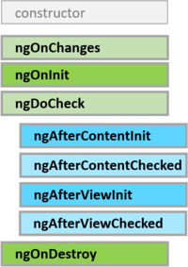
Lifecycle Hooks
Angular manages the lifecycle for components and Directives.

Slide 20
Lifecycle Hooks - Example
@Directive({selector: '[myDirective]'})
export class SampleDirective implements OnInit, OnDestroy {
constructor(private logger: LoggerService) { }
ngOnInit() { this.logState(`Init`); }
ngOnDestroy() {this.logState(`Destroy`); }
private logState(msg: string) {
this.logger.log(msg);
}
}

Slide 21
Forms
2 Types
Template driven
Can’t be unit tested
Complex validation logics in templates makes the code unreadable for designers.
Model driven or Reactive forms
Can be unit tested.
Suites for enterprise applications with lots of complex inter-field business validation logic. Better control and readability.
Special Angular CSS classes
State | Class if true | Class if false
The control has been visited. | ng-touched | ng-untouched
The control's value has changed. | ng-dirty | ng-pristine
The control's value is valid. | ng-valid | ng-invalid

Slide 22
Directives
Three Types of Directives
Components - directives with a template.
Structural directives - change the DOM layout by adding and removing DOM elements.
Eg: NgFor, NgIf
Attribute directives - change the appearance or behavior of an element, component, or another directive.
Eg: NgStyle

Slide 23
Attribute Directive
import { Directive, ElementRef, Input } from '@angular/core';
@Directive({ selector: '[myHighlight]' })
export class HighlightDirective {
constructor(el: ElementRef) {
el.nativeElement.style.backgroundColor = 'yellow';
}
}

Slide 24
Filters/pipes
Angular pipes provide formatting and transformation for data in the template.
Currency : <td>{{movie.price | currency:'USD':true}}</td>
Date : <td>{{movie.releaseDate | date}}</td>
Json : <pre>{{movie | json}}</pre>
Slice : <tr *ngFor="let movie of movies | slice:0:2">
Lowercase : <td>{{movie.title | lowercase}}</td>
Number
<td>{{movie.starRating | number}}</td>
<td>{{movie.starRating | number:'1.1-2'}}</td>

Slide 25
Services
2 Types
Observable
asynchronous operation
Stream of Events
To listen for events in the stream, Subscribe to the Observable
Promise

Slide 26
Observable
hero.service.ts:
import { Observable } from 'rxjs/Observable';
import { of } from 'rxjs/observable/of';
getHeroes(): Observable<Hero[]> {
return of(HEROES);
}
heroes.component.ts:
this.heroService.getHeroes()
.subscribe(
heroes => this.heroes = heroes,
error => this.errorMessage = <any>error);

